Slide 1
INTRODUCTION TO ML/UNDERSTANDING THE PROBLEM
DERE, ABDULHAMEED ABIOLA

Slide 2
OUTLINES
Introduction
Definition
Types of Machine Learning Approach
Understanding the problem
Use case scenarios

Slide 3
INTRODUCTION
Artificial intelligence is the intelligence demonstrated by machines, in contrast to the intelligence displayed by humans.
Artificial Intelligence is a way of making a computer, a computer-controlled robot, or a software think intelligently, in the similar manner the intelligent humans think or in some cases, evolve better than how humans think.

Slide 4
AI is accomplished by studying how human brain thinks and how humans learn, decide, and work while trying to solve a problem, and then using the outcomes of this study as a basis of developing intelligent software and systems.

Slide 5
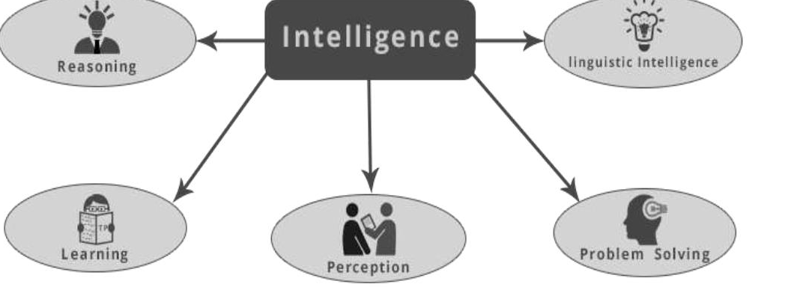

Slide 6
MACHINE LEARNING
It is one of the most popular fields of AI. The basic concept of this filed is to make the machine learning from data as the human beings can learn from his/her experience.
It contains learning models on the basis of which the predictions can be made on unknown data.

Slide 7
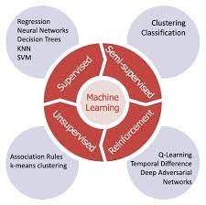
TYPES OF ML APPROACH
Supervised
Semi-Supervised
Unsupervised
Reinforcement

Slide 8
SUPERVISED MACHINE LEARNING
It is defined by its use of labeled datasets to train algorithms that to classify data or predict outcomes accurately.
As input data is fed into the model, it adjusts its weights until the model has been fitted appropriately, which occurs as part of the cross validation process.
Supervised learning helps organizations solve for a variety of real-world problems at scale, such as classifying spam in a separate folder from your inbox.

Slide 9
HOW DOES SUPERVISED ML WORK?
Supervised learning uses a training set to teach models to yield the desired output. This training dataset includes inputs and correct outputs, which allow the model to learn over time.
The algorithm measures its accuracy through the loss function, adjusting until the error has been sufficiently minimized.

Slide 10
TYPES OF SUPERVISED ML
Classification uses an algorithm to accurately assign test data into specific categories. It recognizes specific entities within the dataset and attempts to draw some conclusions on how those entities should be labeled or defined.
Common classification algorithms are linear classifiers, support vector machines (SVM), decision trees, k-nearest neighbor, and random forest.

Slide 11
Regression is used to understand the relationship between dependent and independent variables.
It is commonly used to make projections, such as for sales revenue for a given business.
Linear regression, logistical regression, and polynomial regression are popular regression algorithms.

Slide 12
UNSUPERVISED ML
Unsupervised Learning is a machine learning technique in which the users do not need to supervise the model. Instead, it allows the model to work on its own to discover patterns and information that was previously undetected. It mainly deals with the unlabelled data.

Slide 13
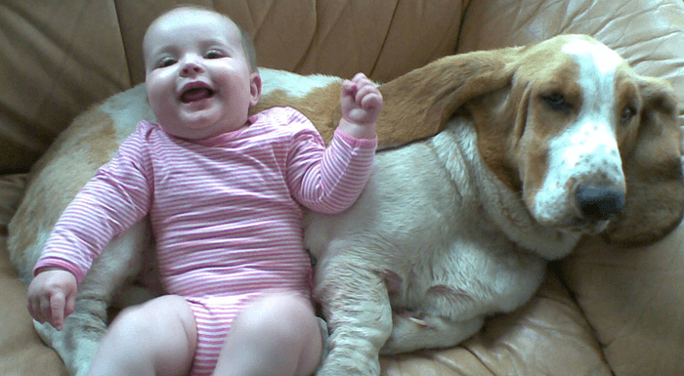

CASE STUDY: A BABY AND HIS DOG

Slide 14
Why Unsupervised Learning?
Unsupervised machine learning finds all kind of unknown patterns in data.
Unsupervised methods help you to find features which can be useful for categorization.
It is taken place in real time, so all the input data to be analyzed and labeled in the presence of learners.
It is easier to get unlabeled data from a computer than labeled data, which needs manual intervention.

Slide 15
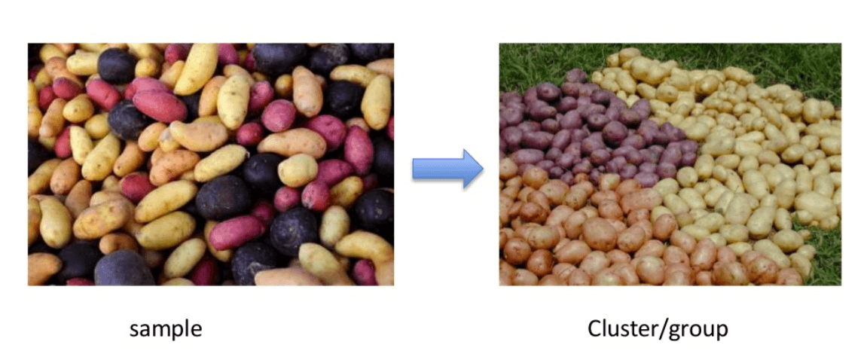
CLUSTERING

Slide 16
UNDERSTANDING THE PROBLEM
CASE 1: A private Secondary school in Abuja decides to use AI in predicting students’ height so as to make it easier for the tailor to sow their uniform. You were contacted as an ML Expert to do this?
What are the likely parameters to ask for?
Will you follow a supervised or unsupervised approach?

Slide 17
ANSWERS
Likely parameters to ask for include:
Age
Weight
Gender
Height
Supervised ML Approach

Slide 18
CASE 2
Suppose you are invited by your project supervisor because he heard you are learning AI with DSN and wants to automate the grading process of his students.
He also told you that he has been giving the students assignments from the first week of lectures and noticed a larger percentage of those who always submit their assignments passed their test.
He is however curious as to how the class performance will be during the exam?

Slide 19
CASE 2 CONT’D
What would you do as a Data Scientist?
What type/nature of data will you ask for?
How do you intend to solve this mystery using Machine Learning?

Slide 20
CASE 3
You are an AI specialist in University of Ilorin Teaching Hospital. At the stroke unit of that same hospital, it was noticed that patients who came in and were 60 years and above improved after 6 weeks of being in the hospital with additional family support
Those who were between 55 and 60 years improved after 8 weeks of being in the hospital with little support.
This has been going on for about a year now

Slide 21
CASE 3
If we want to know how many months/weeks a 45 year old female will use if admitted into the same stroke unit with additional family support.
As a data scientist, is this possible? (answer with reasons)
What would be the likely data to collect or start gathering?
Will this be a classification or regression problem?

Slide 22
CASE 4
Suppose you intend to get an apartment around Tanke, Ilorin for next session but you are planning to do that a month before resumption.
However before going home, you have made survey and have gotten 10 different hostels of choice around that area with different facilities and obviously, different prices

Slide 23
CASE 4 CONT’D
One month to resumption, you hear that there is a new hostel with new facilities, some of which are in the previous hostels you have surveyed, some aren’t.
As a data scientist, if you want to predict the price of that house, what are the most important parameters?
Will this be a supervised or unsupervised approach?

Slide 24
CONCLUSION
YOU ARE WELCOME TO A LONG LASTING JOURNEY IN THE WORLD OF ARTIFICIAL INTELLIGENCE

Slide 25
REFERENCES
Unsupervised Machine Learning, Alrorithm and Types. Accessed from https://www.guru99.com/unsupervised-machine-learning.html
IBM Cloud Education (August 16, 2020). Supervised Machine Learning. Accessed from https://www.ibm.com/cloud/learn/supervised-learning
Artificial Intelligence with python. https://www.tutorialspoint.com/index.htm

Slide 26
THANK YOU FOR LISTENING

